Slide 1
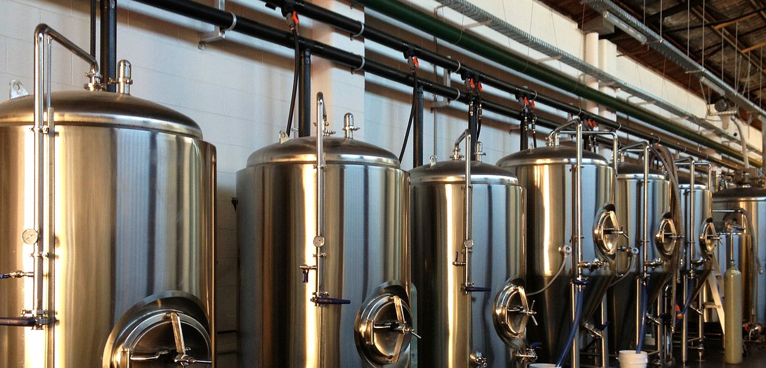

Brewpedia
This Photo by Unknown Author is licensed under CC BY-SA
Ashish Desai
Bejirose K. Stanly
Poonam Kushwaha
Renee Gillmore

Slide 2

Data Sources
Ashish
https://googles.p.rapidapi.com/breweries
https://api.openbrewerydb.org/breweries
https://www.kaggle.com/
https://maps.googleapis.com/maps/api/geocode/json
Bejirose
https://maps.googleapis.com/maps/api/geocode/json
https://maps.googleapis.com/maps/api/place/nearbysearch/json
https://sandbox-api.brewerydb.com/v2/breweries
Poonam
https://maps.googleapis.com/maps/api/place/textsearch/json
Renee
https://www.wine-searcher.com/contact-general?action_F=contactUsViaForm&contact_return_F=/api&subject_F=Trade%20Enquiry%2DAPI%20FREE%20TRIAL

Slide 3
Data Sources - Limitations
Unable to get API Key (Untappd API, TripAdvisor API )
Limited API request calls (Beermapping API)
Limited dataset (Google API)
[20 results per search, 60 max per page_token]
[OpenBreweryDB – 25 results/page max but can iterate over index pages]
Limited dataset (Rapid API)
Static data for data analysis (Kaggle.com)
Paid membership required to BrewerAssociation.com for yearly data, actual production volumes of breweries
Bad/missing Data

Slide 4
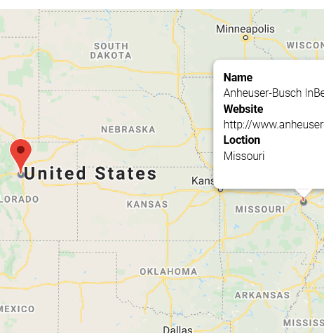
Random US Brewery List
Queried breweryDB API
Cleaned data with no Latitude and Longitude
Marked using latitude and longitude
Heatmap on rating
Pinned on Brewery Name and Website

Slide 5
Data Mangling
Common Issues faced:
NaN on Latitudes and Longitudes
Missing address
Missing City
Missing State
JSON fields expected would be missing
CSV data merge & cleaning
Solved by:
Looking for status = “OK” on JSON results
Used if..else or try..except
When OpenBreweryDB API did not have location info, used GoogleGeocode API to locate Lat, LNG with address, or city/state search.

Slide 6
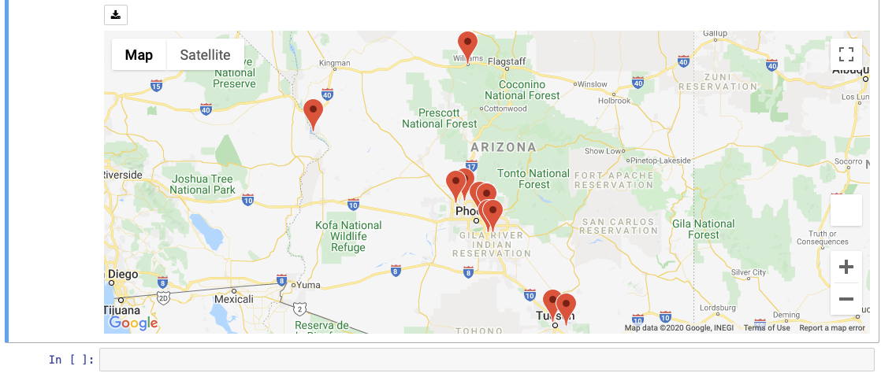
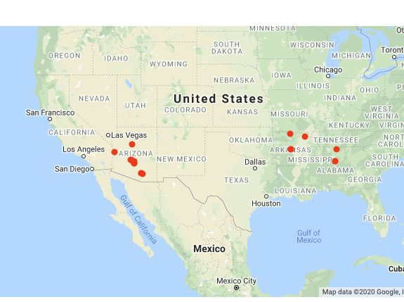
Jupyter GMAP features used
Map type – terrain, satellite
Symbol layer
Marker Layer

Slide 7
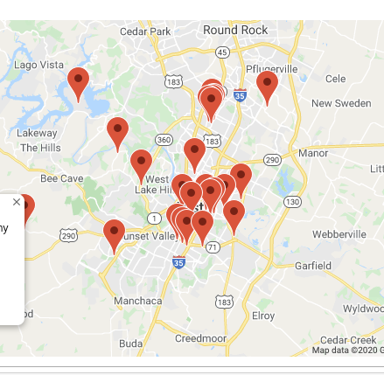
Jupyter GMAP Centering Challenge
Centering for map results display
Took average of Latitudes and Longitudes of results to plot and centered the map on the mean coordinates.

Slide 8
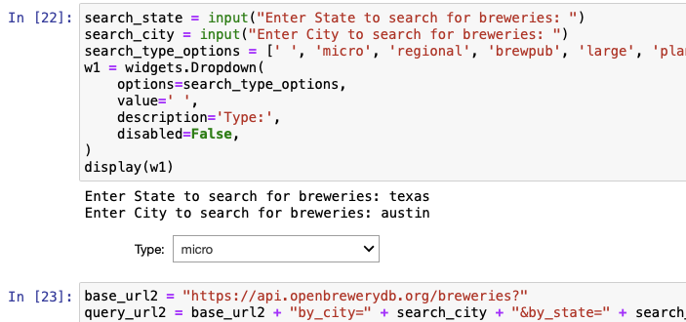
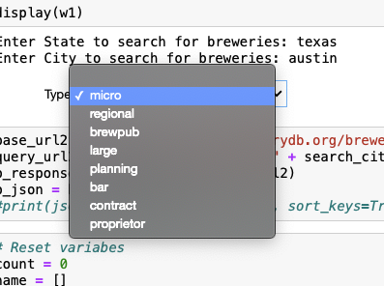
Jupyter pandas WIDGETS
Drop-down menus
import ipywidgets as widgets

Slide 9
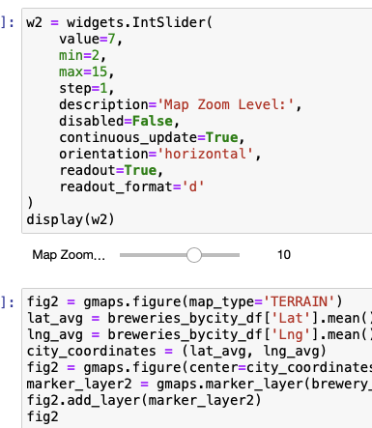
Jupyter pandas WIDGETS
Sliders for map zoom
import ipywidgets as widgets

Slide 10
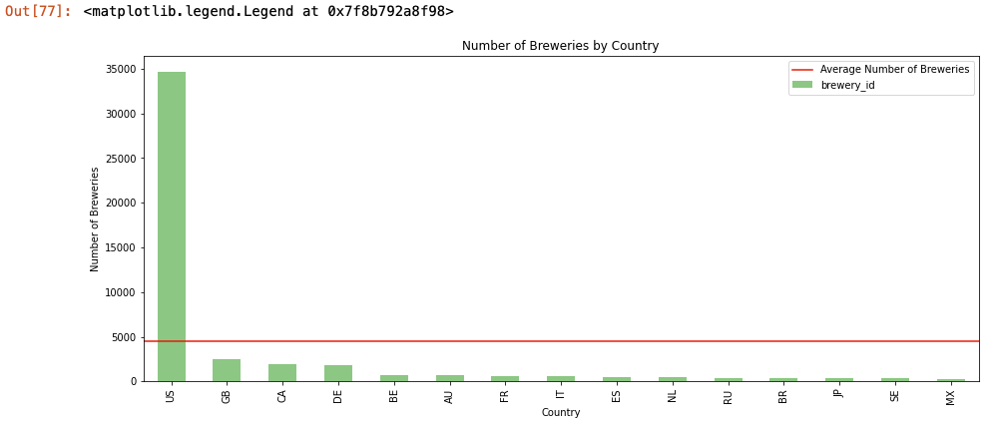
Jupyter matplotlib

Slide 11
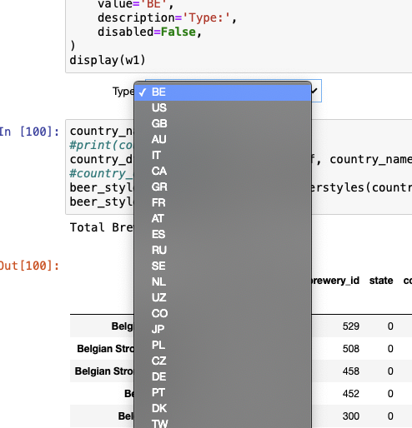
Jupyter matplotlib
Retrieved country list from global breweries data and
Loaded them into a list for drop-down selection so we
Can run report on top brew style by country
Used functions to get top brew styles and plot for each country
American IPA was surprisingly most common in many countries
Except in Germany and Belgium which makes sense given their
history in brewing.

Slide 12
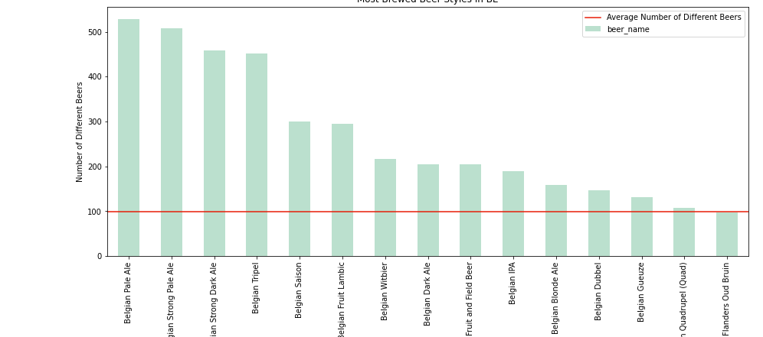
Jupyter matplotlib

Slide 13
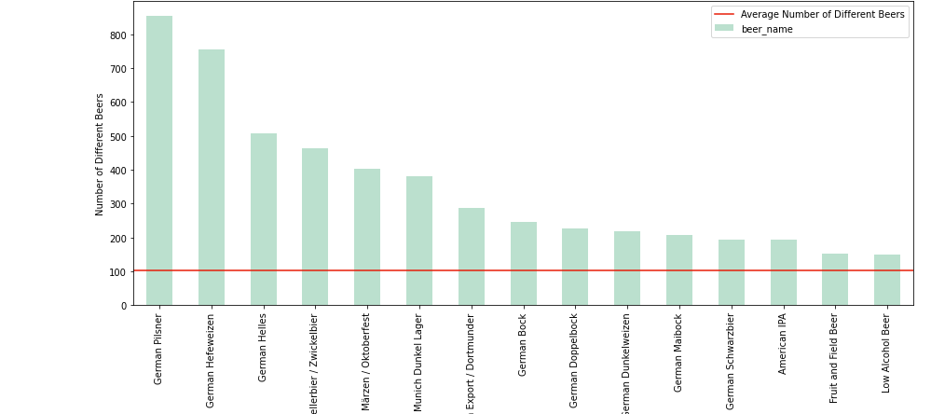
Jupyter matplotlib

Slide 14
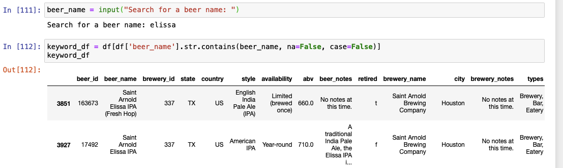
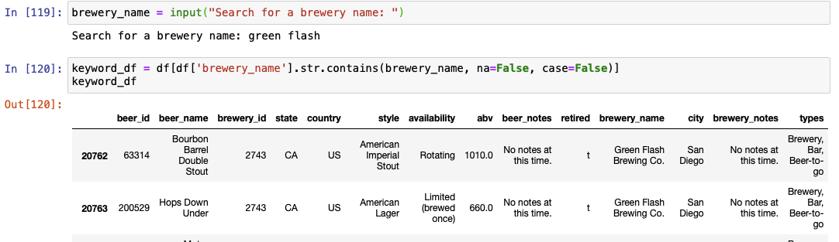
Search beer name or brewery

Slide 15
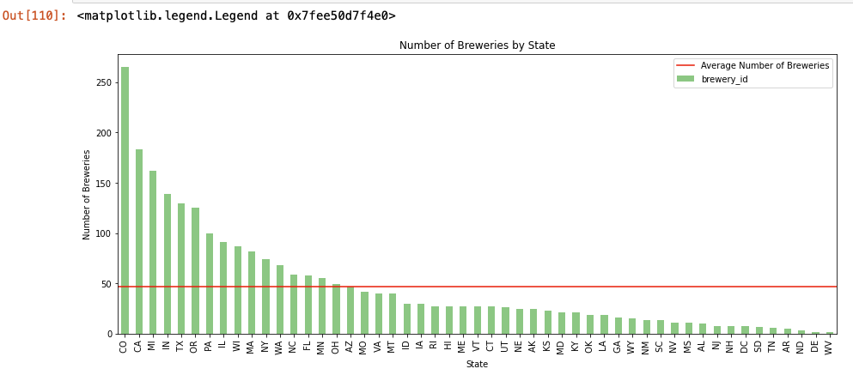
Jupyter matplotlib

Slide 16
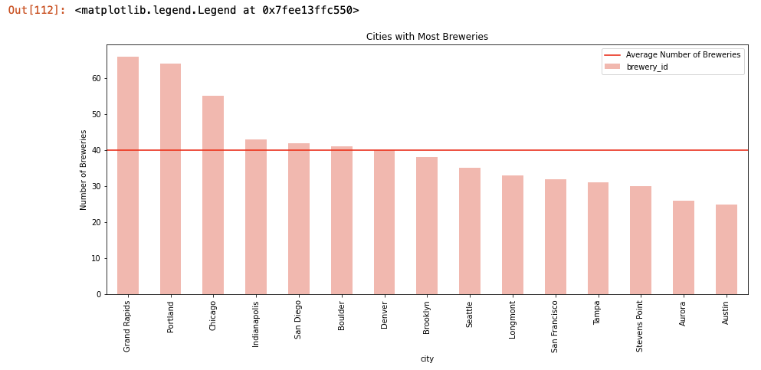
Jupyter matplotlib

Slide 17
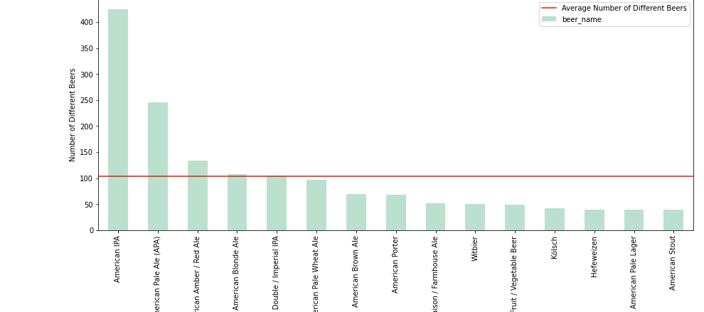
Jupyter matplotlib

Slide 18
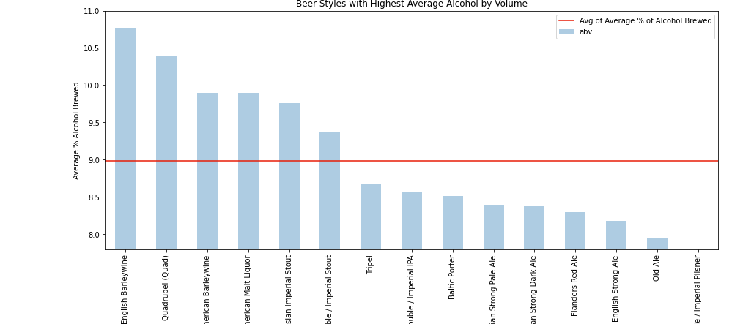
Jupyter matplotlib

Slide 19
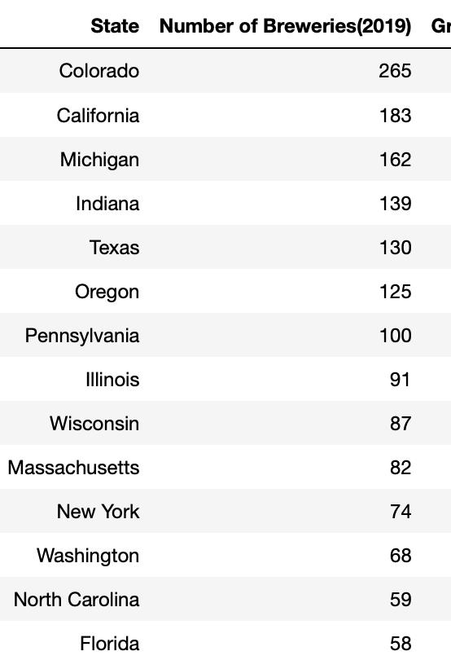
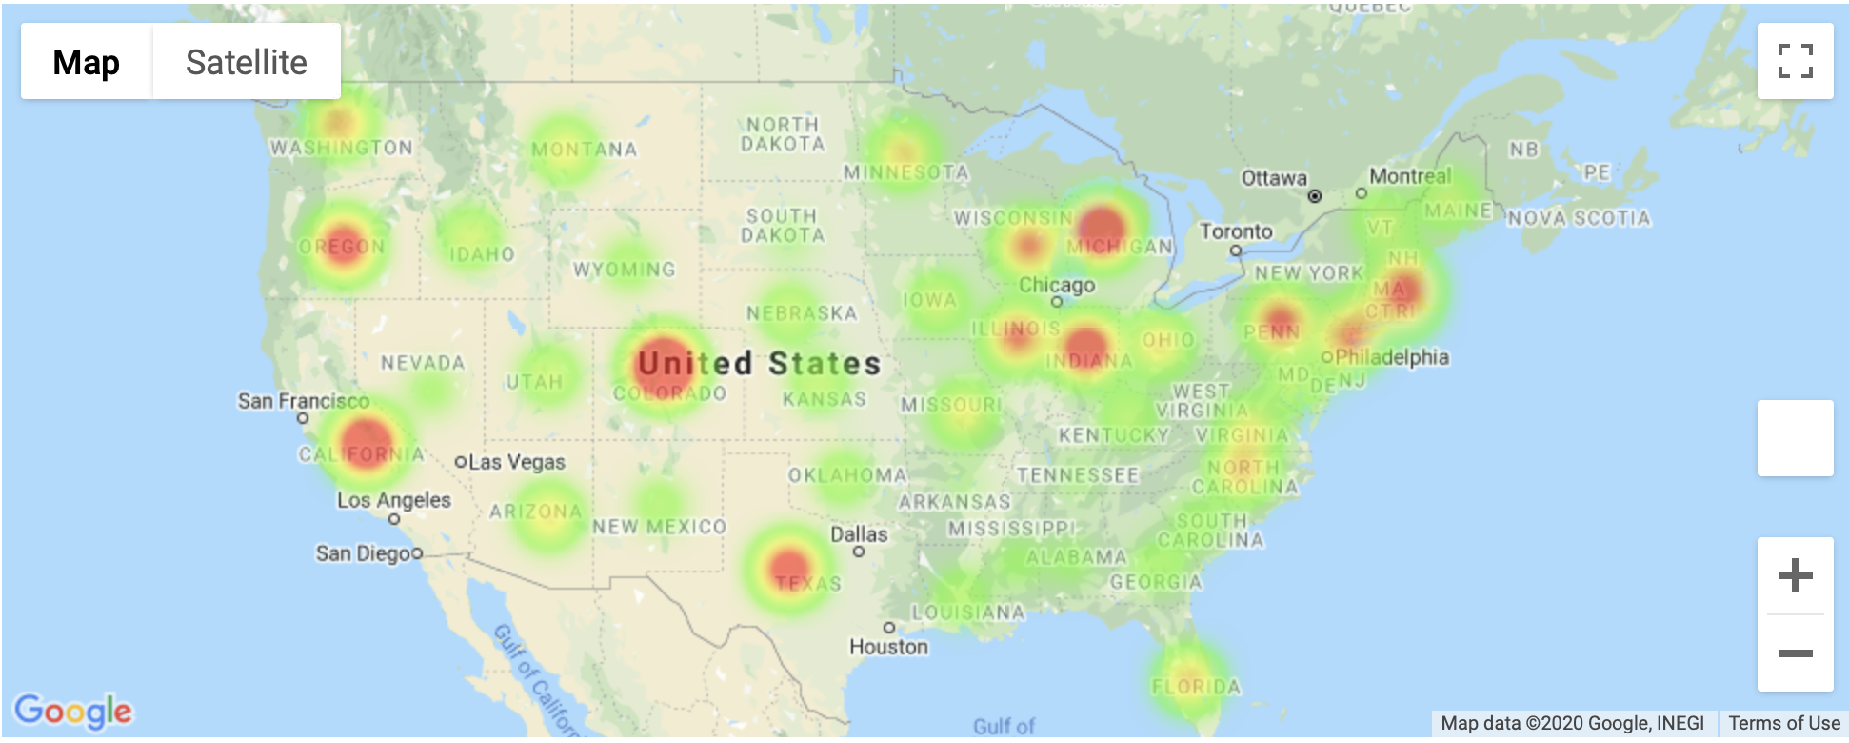
US – Num of Breweries by State (2019)

Slide 20
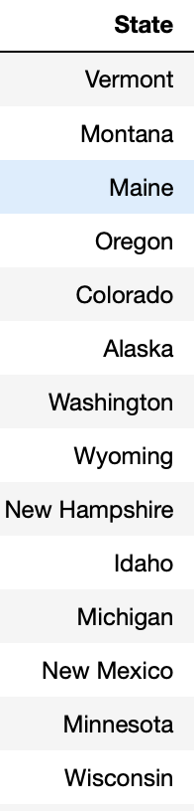
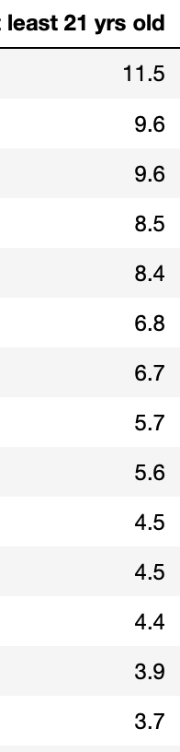
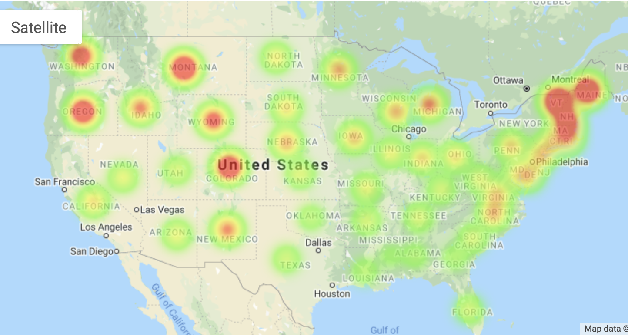
US – Num of Breweries by State per 100,000 residents over age 21 (2019)

Slide 21

Future Enhancements
Include Wineries
Include ingredient analysis
Include “Images”

